Slide 1


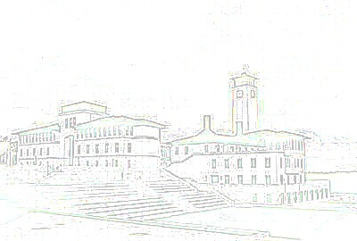
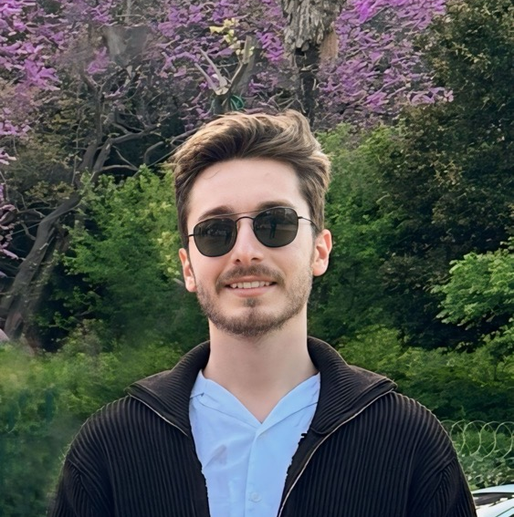
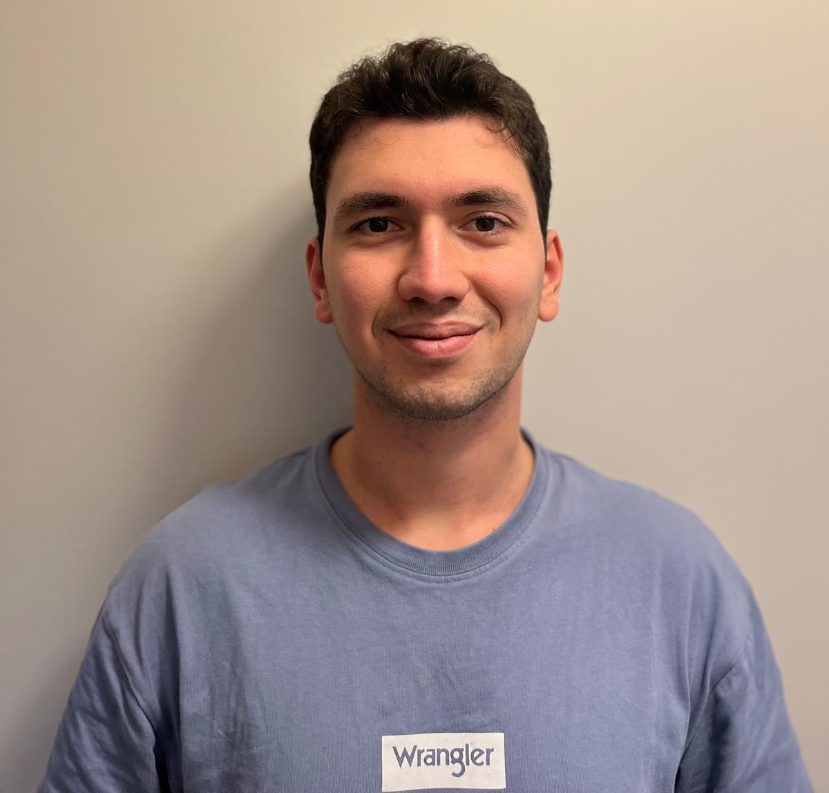
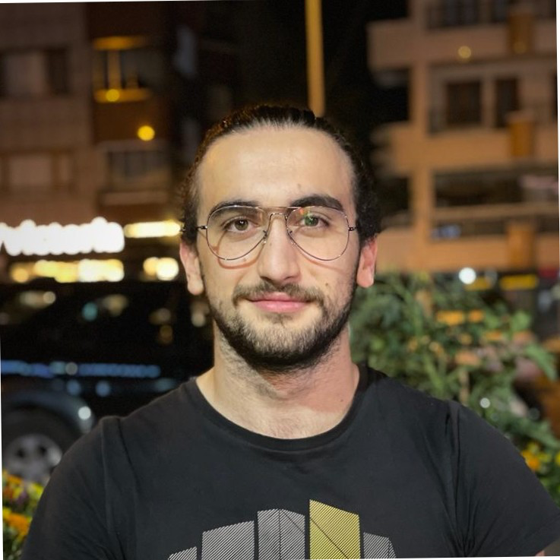
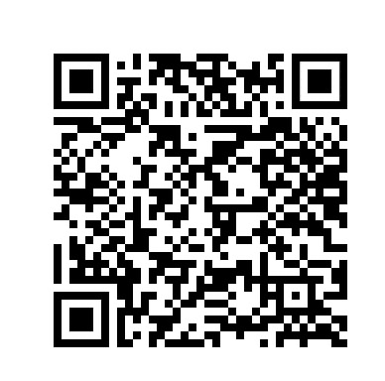

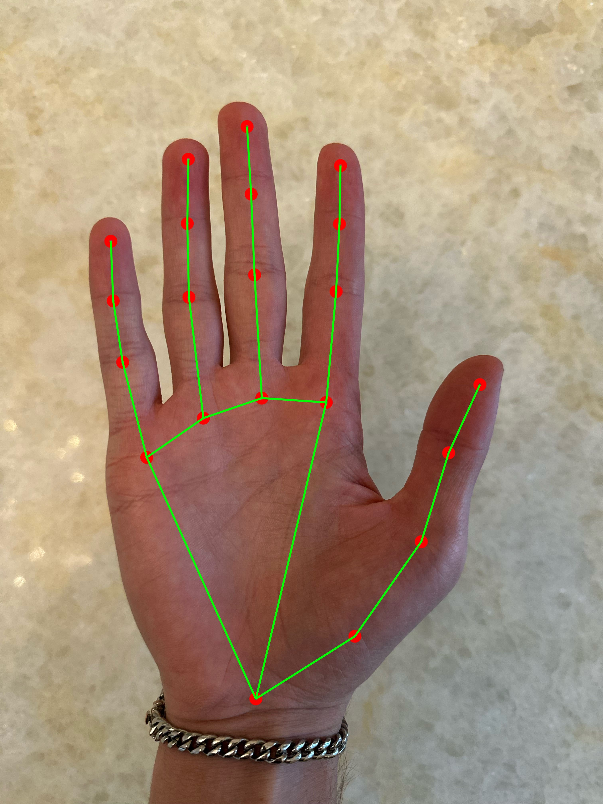
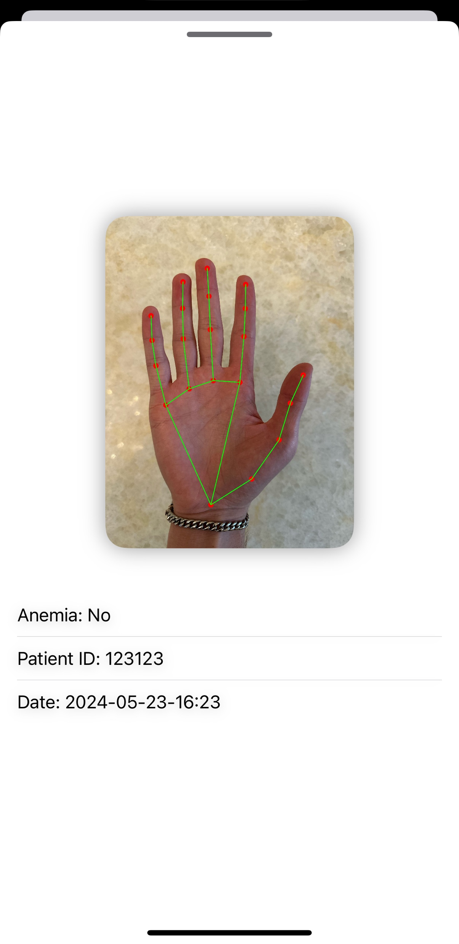



SnapAnemia
Emir Fatih AYYILDIZ, Efe Ispir, Umut Zengin
Advisor: Çiğdem Gündüz Demir, Öznur Özkasap, Özlem Yalçın
Department of Computer Engineering
Koç University
Project Description / Objectives
An anemia diagnosing app that can be used by both Doctors and Patients.
The app uses the patient’s palm image to conduct the test.
Doctors can inspect the previous results of their patients as well as conduct a new test on the spot.
Patients can track the progression of their disease and carry out new tests.
Methods
Hand detection and landmark generation is done by MediaPipe’s Hand Landmarker. Using these landmarks, the image is cropped to extract the palm image.
Both Deep Learning and Analytical based methods are utilized to predict if given image has Anemia.
System Design
The user information and test results are stored in Firebase
MediaPipe is used for hand detection and extraction of region of interest.
Python and OpenCV is utilized for processing the images..
We created a healthcare application that allows registering doctors and patients. The app allows users to make anemia tests within seconds. Users can use the app to make tests and check previous tests.
Doctors can sign-up to create their profiles.
Doctors can sign-in to check their patients. These patients belong to a specific doctor. A doctor cannot see other patients.
Doctors can add a patient to their patient list.
Doctors can check patients list of tests.
Doctor can start a test from patients profile.
By taking a successful photo, a new anemia test is created. Results show 2 important features.
Tests show the photo of patients hand, which the test was created from.
Tests show value of anemia as yes or no.
Patients can enter thier ID to view their list of tests.
Patients can make a new anemia test by scanning their hand.
Each test is uploaded to the database for future use.
Tests are fetched when a patients profile is viewed.
In the future, the app will give more information about the test. Some of these are viewing anemia probability and severity, blood values
Doctors will be able to make tests from a specific part of palm.
Results
System Architecture
When the image of patients hand is taken, hand structure is recognized and a palm section is cut. A trained model calculates anemia possibility, and give a result.
Hand Detection
SnapAnemia
Anemia Detection
References
[1] P. Appiahene et al., “Application of ensemble models approach in anemia detection using images of the
palpable palm,” Medicine in Novel Technology and Devices, vol. 20, pp. 100269–100269, Dec. 2023, doi: https://doi.org/10.1016/j.medntd.2023.100269.
[2] R. G. Mannino et al., “Smartphone app for non-invasive detection of anemia using only patient-sourced photos,” Nature Communications, vol. 9, no. 1, Dec. 2018, doi: https://doi.org/10.1038/s41467-018-07262-2.
[3] P. Appiahene, J. W. Asare, E. T. Donkoh, G. Dimauro, and R. Maglietta, “Detection of iron deficiency anemia by medical images: a comparative study of machine learning algorithms,” BioData Mining, vol. 16, no. 1, Jan. 2023, doi: https://doi.org/10.1186/s13040-023-00319-z.

